Slide 1


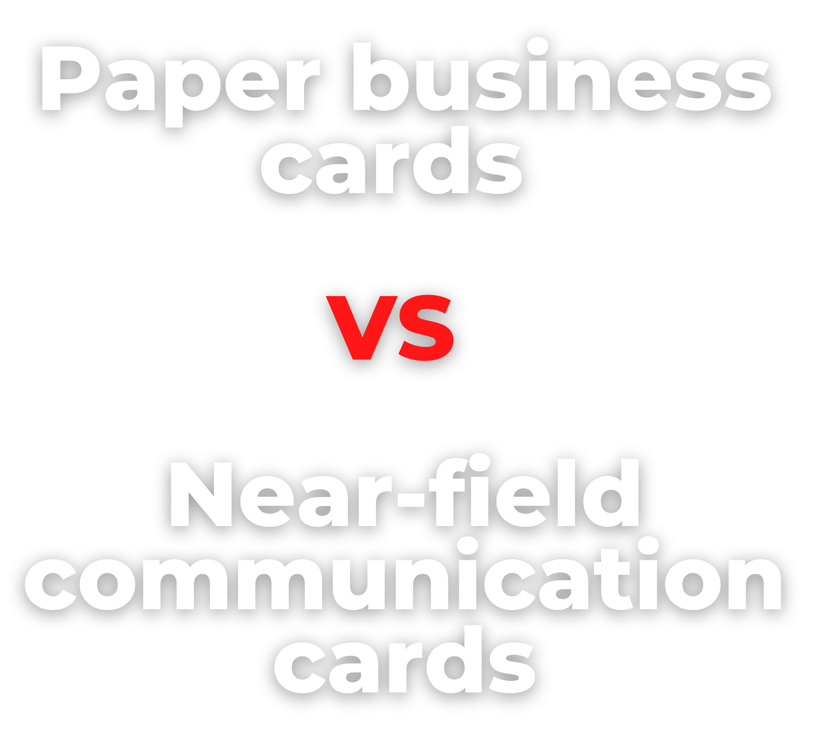
Proje
ct Proposal
prepared for :CEO Dania Saed
By: Manager Saif Haddad

Slide 2
Table of content
The problem
The solution
Goals and Benefits
Deliverables and Success Criteria 5-Project Management Strategy
6-Budget

Slide 3
Table of content
Project Requirements
Project Proposal Timeline 9-Conclusion

Slide 4
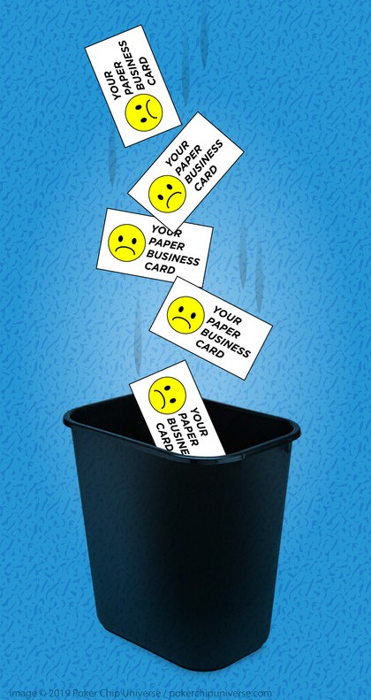


The problem
Over 6 billion paper business
card are thrown yearly
now a day a lot of people use paper business cards and all these cards are thrown after a period of time these cards have a big impact on the environment and it is so hard to recycle paper business cards

Slide 5
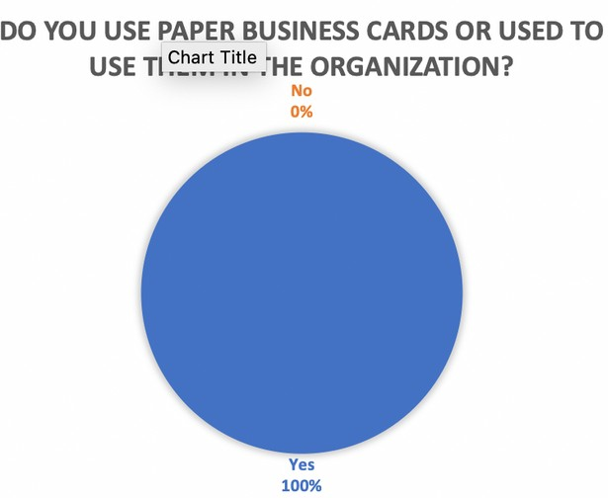
Data Analysis

Slide 6
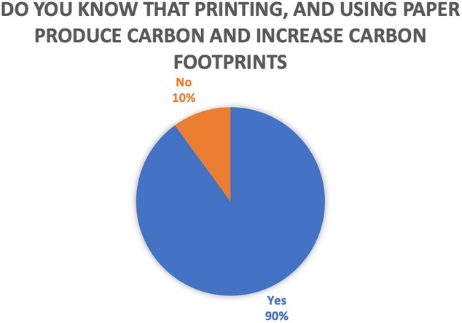
Data Analysis

Slide 7
The Solution
Using permanent NFC business Cards instead of Paper Business Card

Slide 8
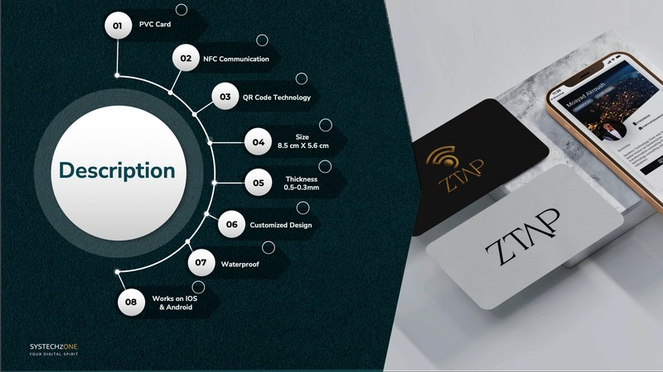

Slide 9
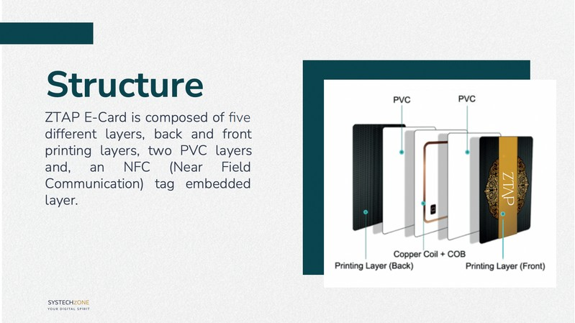

Slide 10
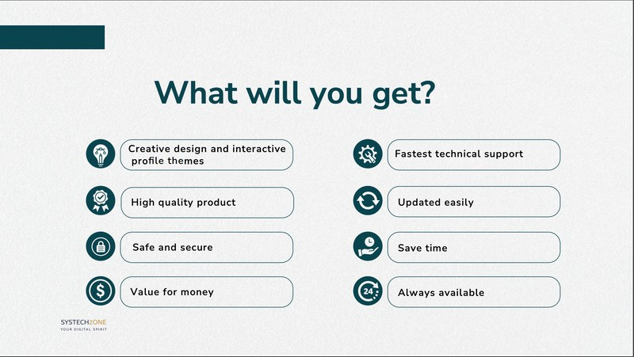

Slide 11


Goals
Produce a product that can be reused and recycled
Save water
Save trees
we will stop cutting trees because we don’t need paper
made of polyethylene
benefit of saving this water such as we use it in watering
can give it back and we can reuse it for another customer
anymore.
trees
producing oxygen
www.reallygreatsite.com

Slide 12
Goals
Decrease the carbon emissions
damage to the ozone
Decrease wastes
Reduce other effects (noise, dust, and traffic)

Slide 13

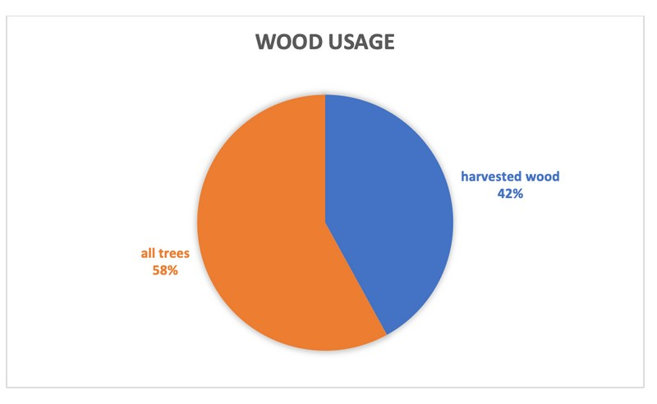
Secondary Data Analysis
www.reallygreatsite.com
Presented By : Larana Corporate

Slide 14
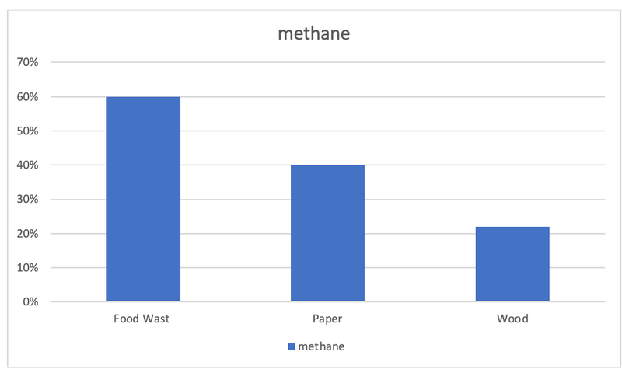
Secondary Data Analysis
www.reallygreatsite.com
Presented By : Larana Corporate

Slide 15
Deliverables
Increase the
dependence on NFC cards.
Positive financial returns
Prepared and launched an informational website about NFC cards.

Slide 16
Success Criteria
20% increase in the usage of NFC cards.
At least 1000 visits to the website within first month
40% increase in the overall financing of the project

Slide 17
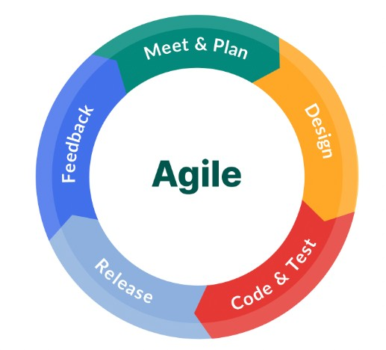
Project Management Strategy
Project with fewer bugs
Allow testing
Allows us to work separately on different phases
Allow step back and make any edit 5-Helps me to compete on time

Slide 18
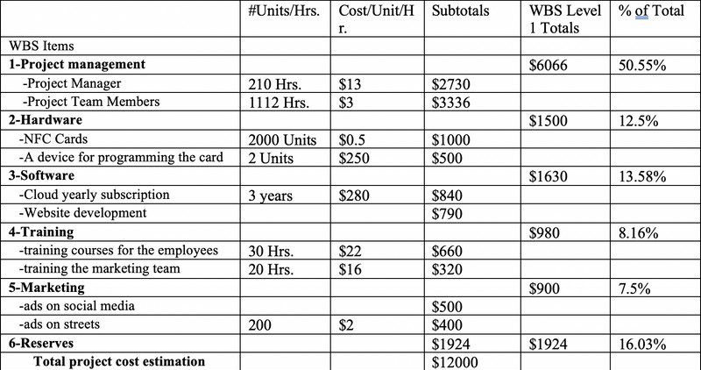
Budget

Slide 19

Project Requirements
NFC chips must be always available

Slide 20

Project Requirements
Senior Web Development

Slide 21

Project Requirements
Employees training course to teach them how to deal with it and how to upload information on it

Slide 22

Project Requirements
The website must be always available for our customers

Slide 23

Project Requirements
The website must contain a form page to insert the information you want to save and a reminder page for appointments

Slide 24

Preliminary proposal approval
Finishing planning phase
Website deployment
17/2/2023
2/5/2023
1/6/2023
Timeline
20/2/2023
20/5/2023
Requirements review
Final proposal approval

Slide 25
Conclusion
1-The problem is the impact of the Paper business cards on the
environment
2-The solution is to produce these NFC business cards
3-I need five requirements:
NFC chips - Senior Web Development - 24h available Website - Training courses - information form on the Website
4-Budget = 12k
6-The profit = 48k
5- The revenue = $60k
7-The ROI = 400%

Slide 26
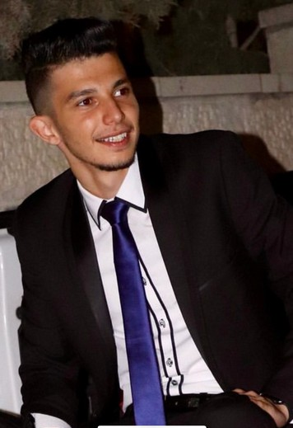
The Project Manager
Saif Haddad
www.reallygreatsite.com
Presented By : Larana Corporate

Slide 27

Presented By : Larana Corporate

